Slide 1


Indian Wells Valley Water District
Celebrating more than 60 Years of Service
www.iwvwd.com
Data Center Overview
With Inyokern Data Center Info

Slide 2
Agenda
The goal is to advise the Board on the facts about Data Centers. It is not to advocate or take any position with respect to Data Centers. Describe what data centers are and what they do Brief history of Data Center development practices Regulatory history and current regulatory trends Compare Data Centers to other similar businesses Electrical Power usage Water Usage Pollution potential California regulatory developments IWV Water and the Proposed Data Center
Serving Our Community for over 60 Years

Slide 3
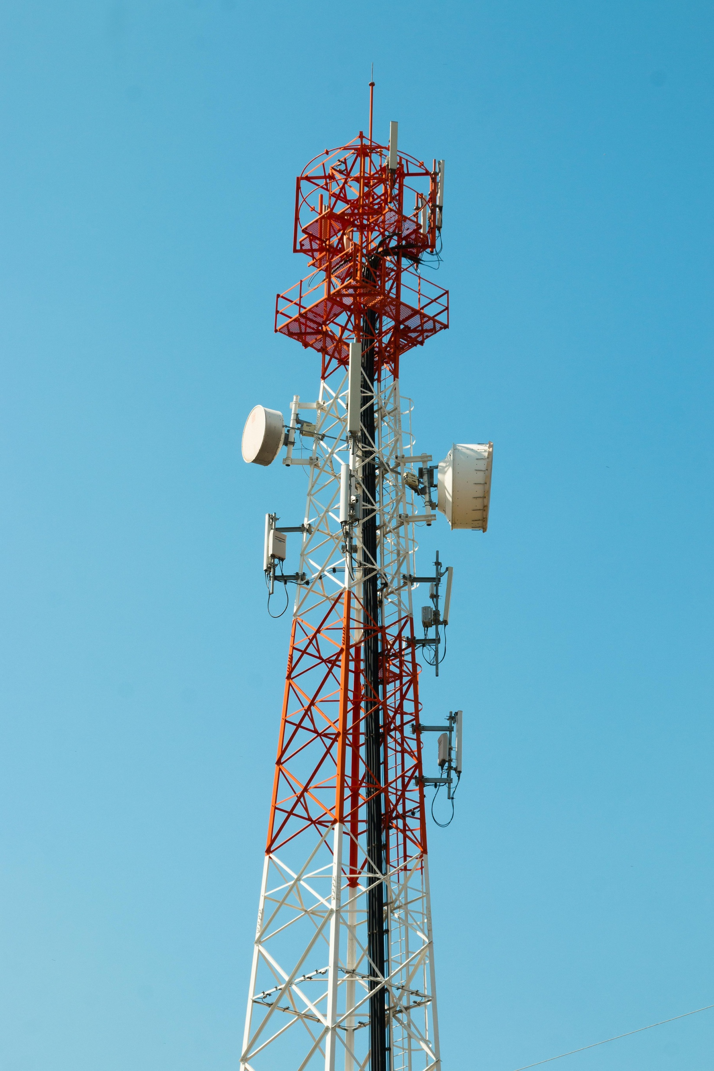
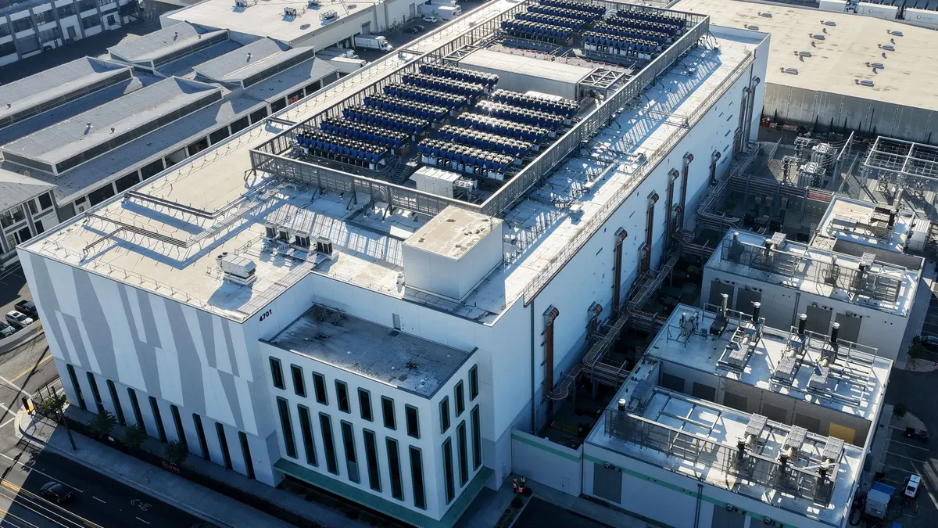

How Does it Work
World Wide Web www.
1
3
You ask Google,
“What is a Data Center”
2
6
5
4
Google Data Center says
“A Data Center is…”
Google’s Data Center
Serving Our Community for over 60 Years

Slide 4

What All is in Data Centers
World Wide Web www.
Answer: A whole lot.
The “Cloud”
Storage of Information
Phone
Text
Video
Games
Streaming Services
This Photo by Unknown Author is licensed under CC BY-SA-NC
Maps and Directions
Banking, Stock Market
Serving Our Community for over 60 Years

Slide 5
A Brief History of “Data Center’s”
1940’s - 1950’s, The First large Computers are Built 1960’s - 1970’s, Mainframes, Miniaturization, Super Computers 1980’s - 1990’s, Internet, Server Rooms, email, databases This is where modern Data Center structures began 2000’s – 2010’s, Cell Phones, Cloud Computing, Typified by massive growth in Data Center size and number Generally not regulated or noticed by the mainstream 2020’s, AI, Streaming, Edge Computing, Growing Demand This is the era of resource constraints (Power and Water)
Serving Our Community for over 60 Years

Slide 6
Regulations Governing “Data Center’s”
1940’s - 1980’s, Few specific regulations, “Building Codes” 1990’s - 2000’s, Local zoning, building permits etc.… Environmental, OSHA plus industry standards for reliability Still few Data Center specific regulations 2010’s – 2020’s, USA, No broad Federal mandates some DOE regs Period of rapid expansion, little public awareness, + tax breaks 2020’s, Projected AI Energy needs begin driving regulations State and Local regulations vs. Federal push for faster approval Over 200 State Bills in 2025, many more in 2026
Serving Our Community for over 60 Years

Slide 7
“Data Center’s”
Compared to Other Business
Electric Power Use, Total U.S. Electrical use 4058 Trillion KWh (TWh) Residential - 1514 TWh in 2025 Commercial – 1493 TWh in 2025 Industrial - 1042+ TWh in 2025 Mining 130 TWh Annually Chemicals and Refining 120 TWh Data Centers 180 TWh in 2024 and growing rapidly (approx. 4%) Warehousing, not included, and far lower than Data Centers Farming, far less than 50 TWh including fertilizer production Source: US Energy Information Agency (eia.gov) Bottom Line: Power use is the biggest concern with Data Centers High Energy Density and high Growth Rate
Serving Our Community for over 60 Years

Slide 8
“Data Center’s”
Compared to Overall Water Use
Water Use, Total U.S. annual water use is approximately 13.5 Trillion gal (USGS) Annual Data Center water use estimates vary 2023 estimate of 17 Billon gallons annually 0.13% (theconversation.com) As high as 73 billion gallons/year by 2028 0.5% (mostpolicyinitiativeorg) Lack of Govt. data is concerning but overall a much smaller impact than electrical However: All sources reviewed note that local conditions matter for water use More on that later
Serving Our Community for over 60 Years

Slide 9
“Data Center’s”
Pollution Issues
Major National Concerns High Energy Demand, Strain on Power Grids Greenhouse Gas emissions from power plants Evaporative Cooling Systems and Wastewater Land use (location) and Habitat Disruption Local Concerns Air and Noise Pollution E-Waste Increased mining for rare earth minerals
Serving Our Community for over 60 Years

Slide 10
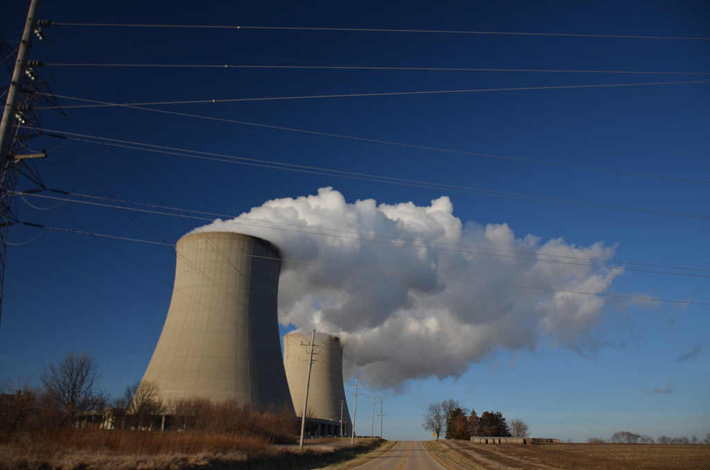
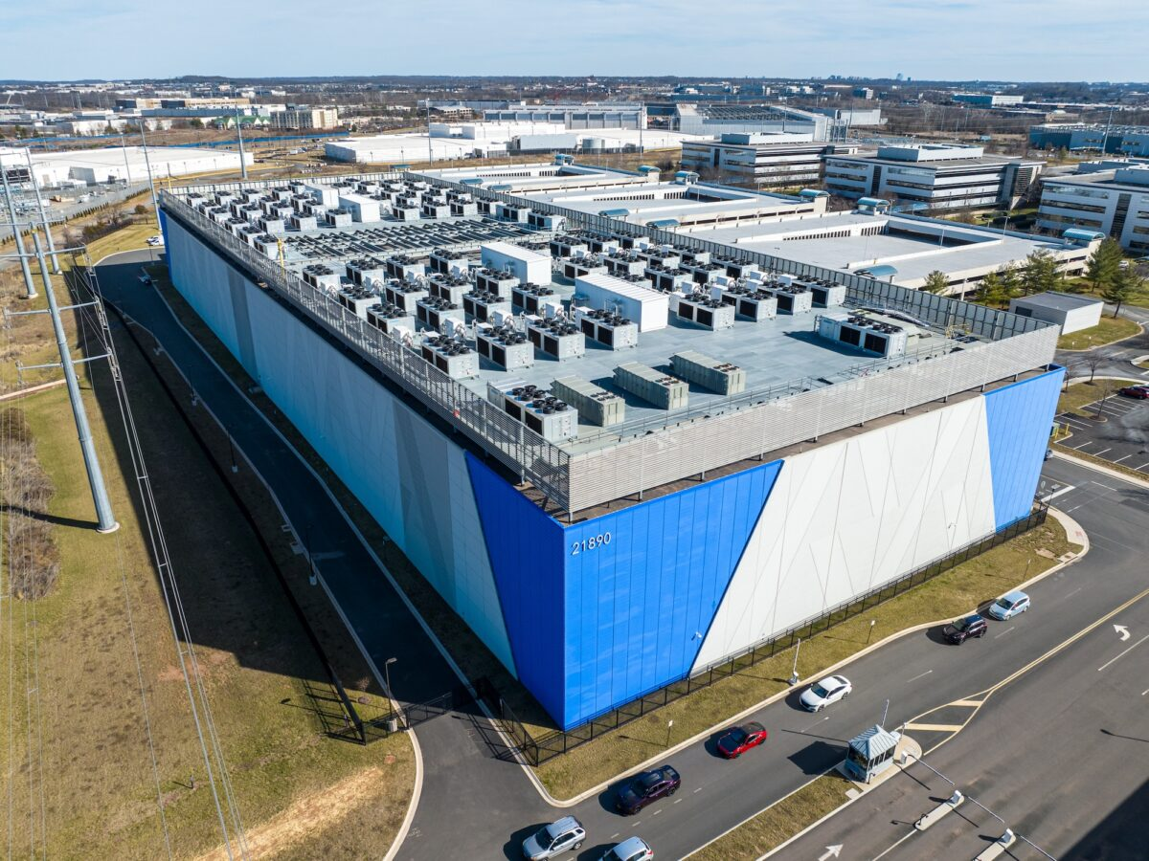
“Data Center’s”
Water Pollution Issues
Water used in Data Centers for cooling must be treated Cooling water may be mixed with corrosion inhibitors and biocides Evaporation also concentrates and increases natural salinity Data Centers using high water volumes can produce effluent
Note: This applies to Data Centers
Cooled primarily with water
More on that later
This Photo by Unknown Author is licensed under CC BY-NC
This Photo by Unknown Author is licensed under CC BY-NC
Serving Our Community for over 60 Years

Slide 11
Proposed Data Center
CEC CEQA Permitting
Approval Process Likely exempt from NEPA, no Federal Funding CEQA, California Energy Commission is the Lead Agency As the Lead Agency, it should consider the following Power use for 99 MW backup generators Water use, cooling etc.… Land use (Impact to Species and Ecosystems) Noise and Light Pollution etc.… If CEC issues an approved CEQA document, permitting shift to local agencies, Air Pollution, Waste Water, County approvals etc.…
Serving Our Community for over 60 Years

Slide 12
Proposed Data Center’s
Local Permitting
Current Regulations Primary Regulation is CEQA Secondary Regulations include: Air Permits for emissions Wastewater permitting for treated wastewater Zoning and building code compliance Possible ESA permitting County Conditional Use Permit (CUP) Current Approval Process for Kern County Kern County Planning Reviews CEQA document Planning Commission holds public meting to approve If approved, decision can be appealed to the Board of Supervisors
Serving Our Community for over 60 Years

Slide 13
Data Center’s
California Law Developments
Current CA Regulations Specific to Data Centers SB 57 – Requires the CPUC to report on whether Data Center electricity use increases rates for other customers (due Jan 1 2027) Senator Steve Padilla author and source of information A proposed law AB-93 to require water use reporting was vetoed by Gov Newsome on Oct 11 2025 (gov.ca.gov) Few State level laws governing Data Centers currently
Serving Our Community for over 60 Years

Slide 14
Data Center’s
California Law Developments
Proposed new CA regulations Specific to Data Centers SB 886 - Tariffs to pay for electrical infrastructure needed to support Data Center electrical demands SB 887 - Prohibits CEQA exemptions for Data Centers AB 1577 – Requires energy/water consumption reporting AB 2619 – Requires detailed water-use disclosure and planning requirements for proposed data centers AB 2469 – Data Center Permitting. Requires that Data Centers pay for water infrastructure needed to operate. This is not a comprehensive list and none of these are law yet
Serving Our Community for over 60 Years

Slide 15
Inyokern Data Center
Proposed Water Usage
The proponent has proposed the following plan Significantly reduce water use through “dry cooling” Evaporative cooling only during peak temperatures ASHRAE Standard for Data Center Temp is 64-81 degrees inside Dry Cooling can achieve the ASHRAE standard when outside temps are approximately below 90 degrees with no water use When temps are above 90 degrees supplemental evaporative cooling will be required
Serving Our Community for over 60 Years

Slide 16
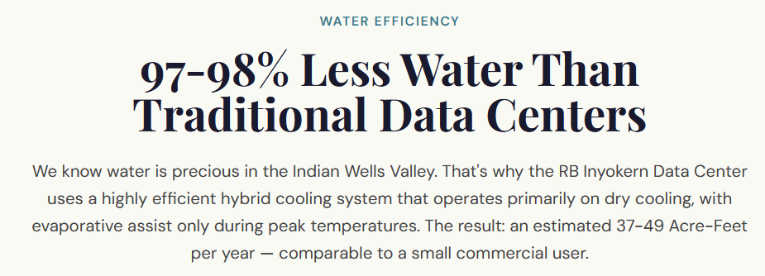
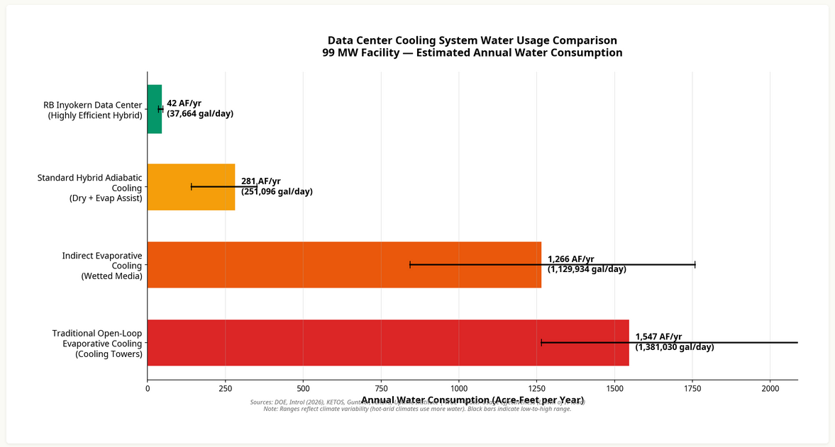
SGMA + Adjudication
Educational town hall materials - not legal advice
11

Slide 17
Data Center Concerns
Actual water usage is unknown Source of water unknown Significance of light and noise pollution The extent to which will the Data Center invest in local infrastructure
Serving Our Community for over 60 Years

Slide 18
Questions?
?
Serving Our Community for over 60 Years

