Slide 1

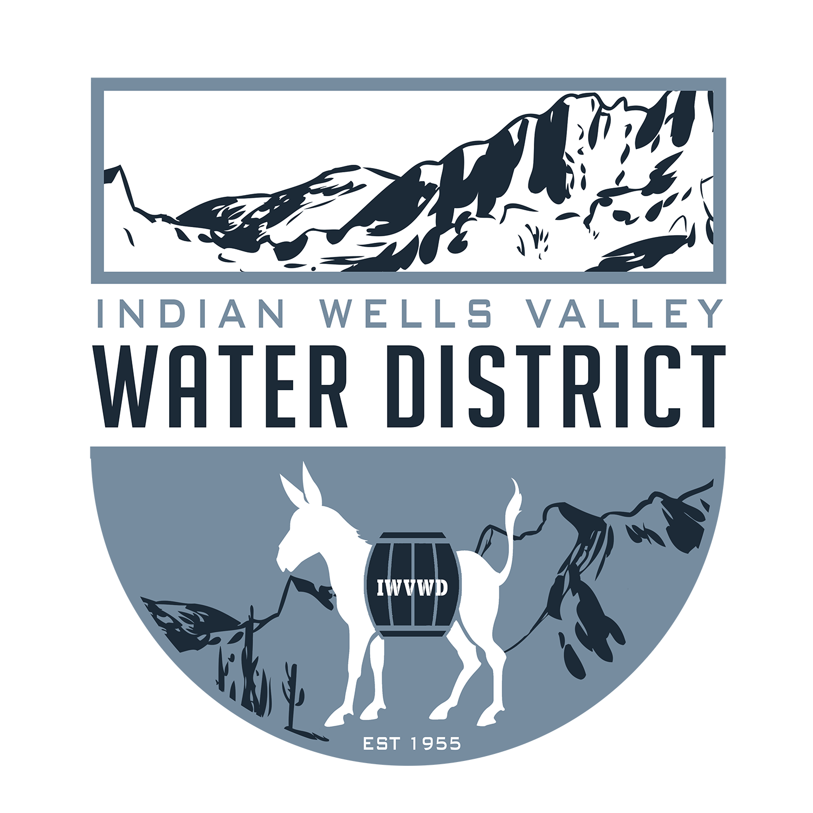
Indian Wells Valley Water District
Celebrating more than 60 Years of Service
www.iwvwd.com
WRDA Overview
Imported Water Pipeline Project

Slide 2
Executive Summary
Based on a review of historical appropriations, it does not appear that the Imported Water Pipeline Project will receive funding Additionally, if funding is received, it will likely be several years out, and not anywhere near the requested $150M What factors contribute to this assessment? The Environmental Infrastructure (EI) Program is grossly underfunded The Congressional Research Service 2025 report on EI documents historical Appropriation levels far below Authorizations The same report recommends significant changes to the EI Program Current Executive Branch guidance to the ACOE requests no new starts A Congressional “earmark” is highly unlikely for this project The GA may have additional information that might alter my assessment and should provide clarifications if warranted
Serving Our Community for over 60 Years

Slide 3
Understanding “WRDA Terminology”
What authority allows for this type of project” Section 219(f) of WRDA allows the Army Corps of Engineers to work with local agencies/sponsors 75% Federal/25% local funding requirement as well has having a qualified “local sponsor” are required Thus, the Imported Waterline Project is sometimes referred to as a “219 project” These projects are NOT part of the ACOE Primary Mission
Serving Our Community for over 60 Years

Slide 4
Understanding “WRDA Terminology”
What is the Environmental Infrastructure (EI) Project Program? EI is one of several programs under WRDA and was first authorized under WRDA 1992 Environmental Infrastructure projects are for wastewater, water, treatment and storage The latest Executive Branch 2025 guidance for ACOE states “Environmental Infrastructure programs and projects are inconsistent with Executive Branch policy for Civil Works.” and “No agreements should be signed that contemplate future, unfunded increments of work.”
Serving Our Community for over 60 Years

Slide 5
Understanding “WRDA Authorizations”
WRDA only Authorizes Projects, no funds are “Appropriated” The real question is, “How many projects have been authorized and how much funding is available for these projects?” What we know about this question There have been 598 projects “authorized” for $18 Billion 400 projects remain in work, partially funded, or unfunded WRDA 2022 authorized 132 projects for $4.256B WRDA 2024 authorized 193 projects for approximately $3.3B The Congressional Research Service report to Congress dated 6/27/2025 provides historical and future analysis of the EI Program
Serving Our Community for over 60 Years

Slide 6
Understanding “The WRDA EI Program”
How does the ACOE prioritize and fund EI Projects The 2028 ACOE Program Development Guidance document states the following; There are over 400 different EI authorities, and each one comes with different funding caps, geographic focus areas, types of assistance, requirements, et cetera. EI authorities are distinct from traditional Civil Works (CW) missions; therefore, EI has been a lower budget priority and generally excluded from USACE budget recommendations. Instead, EI receives annual appropriations through 1. Congressional earmarks, 2. additional funding in the Work Plan, or 3. carve-outs in Supplemental bills
Serving Our Community for over 60 Years

Slide 7
CRS Report to Congress The Three Paths to Funding
Energy and Water Development and Related Agencies Bill This is the primary funding bill for the USACOE EI Funding referred to as “Work Plan Additional Funding” Supplemental Bills may also include EI Funding Example: Continuing Resolutions have included EI funding Example: Disaster Relief Supplemental Appropriations Act of 2025 Members of Congress may “earmark” funding to a specific EI project as well (CPF/CDS Funding on the next slide) Member of Congress limited to 15 “earmarks’ per year Senators have a limit of 1% of total budget combined This funding may be inserted into almost any Appropriation Bill
Serving Our Community for over 60 Years

Slide 8
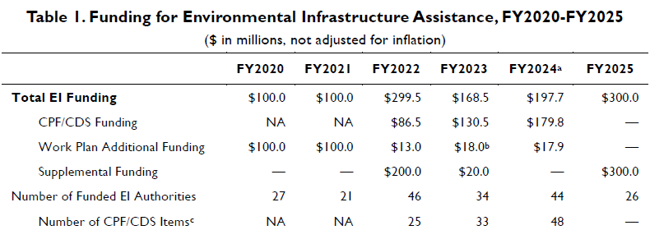
CRS Report to Congress “EI Actual Funding”
Serving Our Community for over 60 Years

Slide 9
What does “Oversubscribed” Mean
Congress has “Authorized” $18 Billion in EI Projects, BUT, is only “Appropriating” at about $200M annually. Meaning, it will take 90 years to fund only those projects currently “Authorized” not counting future requests
Serving Our Community for over 60 Years

Slide 10
CRS Report to Congress “Recommendations”
The CRS report recommends that Congress address this problem in one of the following ways Deauthorize currently “Authorized” Projects This authority already exists but has not been used Should the USACOE be doing these projects at all? Other similar federal programs already exist More clearly define how EI projects get funded (three options) Only via Congressional Requests Risk and benefit criteria if Appropriations are included as a part of regular funding Other methods
Serving Our Community for over 60 Years

Slide 11
What is the GA Currently Doing to Fund the Pipeline
Oct 2025 – GA Board Packet states that the GA is working to execute an agreement with the ACOE under the Planning Assistance to States Program (PAS) No agreement has been mentioned since Oct 2025 No construction is allowed under the PAS Program There is a 50/50 funds matching requirement for this program The proposed 2026 GA Budget has a $50k line item for Stetson PAS support Purpose of funds unclear Nov 2025 – GA board approved a $5M “earmark” request for WRDA funding A review of the relevant congressional CPF (earmark) requests does not show any request has been put forward by either the House or Senate members representing the area as of 04/01/2026
Serving Our Community for over 60 Years

Slide 12
What Other Options Exist to Fund the Pipeline (Loans)
WIFIA – Water Infrastructure Finance and Innovation Act A Federal “loan” program, not a Grant Program Requires a 50% match for funding Can be coupled with an SRF Loan All costs must be repaid SRF – State Revolving Fund This is a State run “loan” program, not Grant Program Loans are primarily for Agencies or Districts with dedicated utility revenue In general, no cost sharing required GA would likely have difficulty competing due to no dedicated utility revenue Ultimately, loan programs such as these would require full repayment of the Pipeline Cost, making them unlikely sources for GA Pipeline Funding
Serving Our Community for over 60 Years

Slide 13
What Other Options Exist to Fund the Pipeline (Grants)
There are other Grant programs that the GA could or can use Federal Grant Programs Water SMART, 25% Federal Share, only for recycling projects Water System IRS, for design/planning, already being used by GA California Grant Programs Prop 1 (2014) IRWM, 50% State share Prop 1 Recycling Grants 35% State Share (not for pipelines) Prop 1 Water Storage investment Program 50% (not for pipelines) Prop 4 Limited funding for SGMA and related projects Primary focus is recycling, GW storage etc… I would expect the GA to petition for these funds but they will have issues competing with other projects
Serving Our Community for over 60 Years

Slide 14
What Does all this Mean
The chances that the EI project will get funded are very low absent community support for the project. A direct earmark appears to be the only reasonable path for pipeline funding under EI The pursuit of EI by the GA is not unreasonable given the higher cost share and or limited scope of other avenues However: EI authorization is not limited to just the Imported Water Pipeline, other projects can be proposed under the WRDA authority Other clear beneficial options do exist Recycled Water Capture of LADWP overflows and storm water and Water Banking
Serving Our Community for over 60 Years

Slide 15
Comments – Questions?
Serving Our Community for over 60 Years

